Slide 1
Module #9: Virtual Point Transformation (VPT)

Slide 2
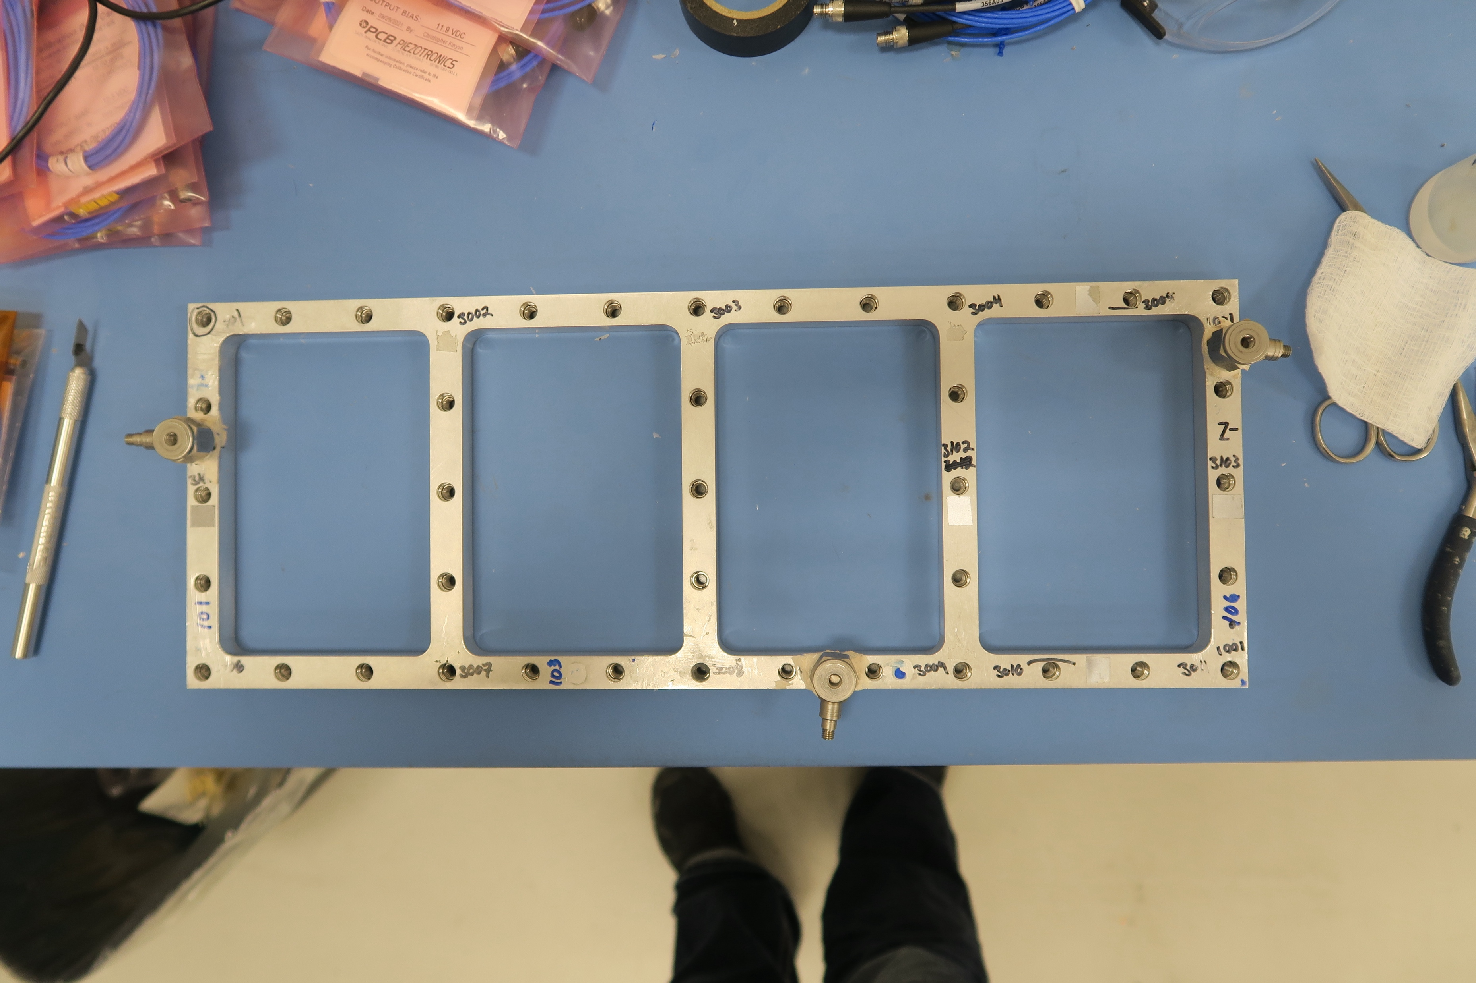
Required Information in Substructuring
Substructuring is all about the interface modeling and missing information can lead to significant errors
Coupling location in threaded hole
Available Instrumentation Locations

Slide 3
Why is the VPT Used?
The VPT is an experimental technique for interface modeling and interface weakening
Used to obtain measurements at the coupling locations
Used to indirectly measure rotations
Preprocesses the data with a spatial filter – interface weakening

Slide 4
Why is the VPT Used?
The VPT is an experimental technique for interface modeling and interface weakening
Used to obtain measurements at the coupling locations
Used to indirectly measure rotations
Preprocesses the data with a spatial filter – interface weakening

Slide 5
Why is the VPT Used?
The VPT is an experimental technique for interface modeling and interface weakening
Used to obtain measurements at the coupling locations
Used to indirectly measure rotations
Preprocesses the data with a spatial filter – interface weakening

Slide 6
Why is the VPT Used?
The VPT is an experimental technique for interface modeling and interface weakening
Used to obtain measurements at the coupling locations
Used to indirectly measure rotations
Preprocesses the data with a spatial filter – interface weakening

Slide 7
Interface Modeling with VPT

Slide 8
Interface Modeling with the VPT
The VPT transforms several “easy” measurements to data at the coupling location
Physical Measurements
VPT Interface Model
X
Y
VPT
X
X
X
RZ
Y
Y
Y

Slide 9

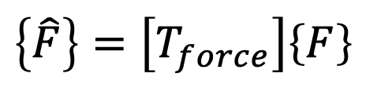
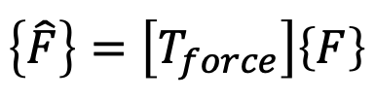
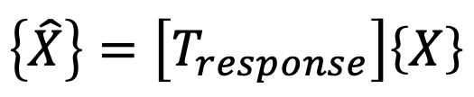

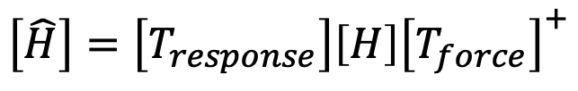

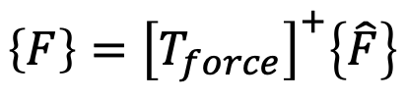

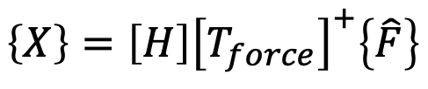
What is the Math for the VPT?
Basic Transformations
FRF with Response Transformation
$$\left\{\hat{X}\right\}=\left[T_{response}\right]\left\{X\right\}$$
$$\left\{\hat{X}\right\}=\left[T_{response}\right]\left\{X\right\}$$
$$\left\{X\right\}=\left[H\right]\left\{F\right\}$$
$$\left\{\hat{F}\right\}=\left[T_{force}\right]\left\{F\right\}$$
$$\left\{\hat{X}\right\}=\left[T_{response}\right]\left[H\right]\left\{F\right\}$$
FRF with Force Transformation
FRF Transformation
$$\left\{\hat{F}\right\}=\left[T_{force}\right]\left\{F\right\}$$
$$\left\{X\right\}=\left[H\right]\left\{F\right\}$$
$$\left[\hat{H}\right]=\left[T_{response}\right]\left[H\right]{\left[T_{force}\right]}^{+}$$
$$\left\{F\right\}={\left[T_{force}\right]}^{+}\left\{\hat{F}\right\}$$
$$\left\{X\right\}=\left[H\right]{\left[T_{force}\right]}^{+}\left\{\hat{F}\right\}$$
The VPT math uses basic transformation matrices and variable exchanges

Slide 10
What is the Math for the VPT?
Basic Transformations
FRF with Response Transformation
$$\left\{\hat{X}\right\}=\left[T_{response}\right]\left\{X\right\}$$
$$\left\{\hat{X}\right\}=\left[T_{response}\right]\left\{X\right\}$$
$$\left\{X\right\}=\left[H\right]\left\{F\right\}$$
$$\left\{\hat{F}\right\}=\left[T_{force}\right]\left\{F\right\}$$
$$\left\{\hat{X}\right\}=\left[T_{response}\right]\left[H\right]\left\{F\right\}$$
FRF with Force Transformation
FRF Transformation
$$\left\{\hat{F}\right\}=\left[T_{force}\right]\left\{F\right\}$$
$$\left\{X\right\}=\left[H\right]\left\{F\right\}$$
$$\left[\hat{H}\right]=\left[T_{response}\right]\left[H\right]{\left[T_{force}\right]}^{+}$$
$$\left\{F\right\}={\left[T_{force}\right]}^{+}\left\{\hat{F}\right\}$$
$$\left\{X\right\}=\left[H\right]{\left[T_{force}\right]}^{+}\left\{\hat{F}\right\}$$
The VPT math uses basic transformation matrices and variable exchanges

Slide 11
What is the Math for the VPT?
Basic Transformations
FRF with Response Transformation
$$\left\{\hat{X}\right\}=\left[T_{response}\right]\left\{X\right\}$$
$$\left\{\hat{X}\right\}=\left[T_{response}\right]\left\{X\right\}$$
$$\left\{X\right\}=\left[H\right]\left\{F\right\}$$
$$\left\{\hat{F}\right\}=\left[T_{force}\right]\left\{F\right\}$$
$$\left\{\hat{X}\right\}=\left[T_{response}\right]\left[H\right]\left\{F\right\}$$
FRF with Force Transformation
FRF Transformation
$$\left\{\hat{F}\right\}=\left[T_{force}\right]\left\{F\right\}$$
$$\left\{X\right\}=\left[H\right]\left\{F\right\}$$
$$\left[\hat{H}\right]=\left[T_{response}\right]\left[H\right]{\left[T_{force}\right]}^{+}$$
$$\left\{F\right\}={\left[T_{force}\right]}^{+}\left\{\hat{F}\right\}$$
$$\left\{X\right\}=\left[H\right]{\left[T_{force}\right]}^{+}\left\{\hat{F}\right\}$$
The VPT math uses basic transformation matrices and variable exchanges

Slide 12
What is the Math for the VPT?
Basic Transformations
FRF with Response Transformation
$$\left\{\hat{X}\right\}=\left[T_{response}\right]\left\{X\right\}$$
$$\left\{\hat{X}\right\}=\left[T_{response}\right]\left\{X\right\}$$
$$\left\{X\right\}=\left[H\right]\left\{F\right\}$$
$$\left\{\hat{F}\right\}=\left[T_{force}\right]\left\{F\right\}$$
$$\left\{\hat{X}\right\}=\left[T_{response}\right]\left[H\right]\left\{F\right\}$$
FRF with Force Transformation
FRF Transformation
$$\left\{\hat{F}\right\}=\left[T_{force}\right]\left\{F\right\}$$
$$\left\{X\right\}=\left[H\right]\left\{F\right\}$$
$$\left[\hat{H}\right]=\left[T_{response}\right]\left[H\right]{\left[T_{force}\right]}^{+}$$
$$\left\{F\right\}={\left[T_{force}\right]}^{+}\left\{\hat{F}\right\}$$
$$\left\{X\right\}=\left[H\right]{\left[T_{force}\right]}^{+}\left\{\hat{F}\right\}$$
The VPT math uses basic transformation matrices and variable exchanges

Slide 13
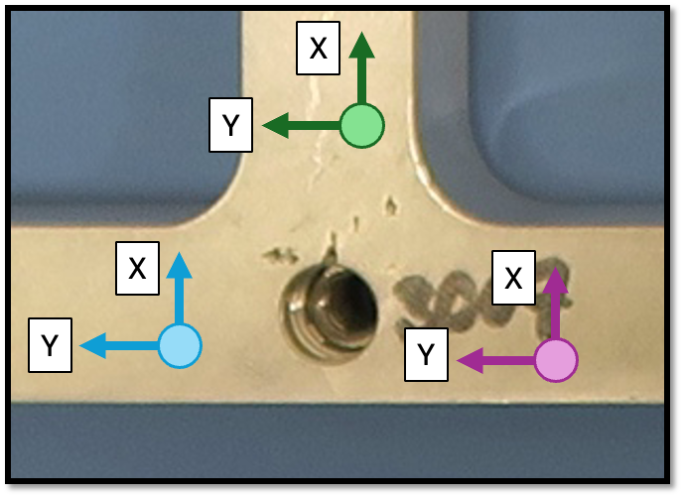
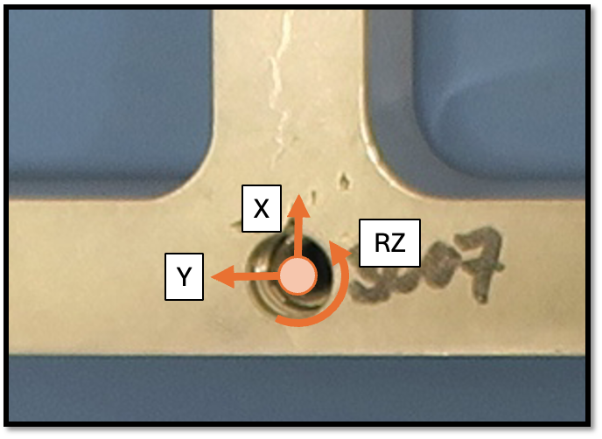

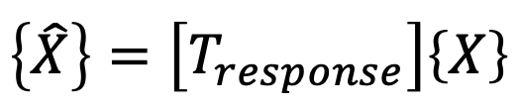
Building Transformation Matrices
The transformations are built as mode shapes about the virtual point
$$\left\{\hat{X}\right\}=\left[T_{response}\right]\left\{X\right\}$$
$$\left\{U\right\}={\left[φ\right]}^{+}\left\{X\right\}$$
Most VPT applications only use rigid body shapes
This is the same as a kinematic transformation
There is some interest in using elastic shapes
Which elastic shapes are important for interface dynamics?
How do we get consistent coupling DOFs between structures?
Need to make sure that the selected shapes capture the interface dynamics
VPT

Slide 14
Building Transformation Matrices
The transformations are built as mode shapes about the virtual point
$$\left\{\hat{X}\right\}=\left[T_{response}\right]\left\{X\right\}$$
$$\left\{U\right\}={\left[φ\right]}^{+}\left\{X\right\}$$
Most VPT applications only use rigid body shapes
This is the same as a kinematic transformation
There is some interest in using elastic shapes
Which elastic shapes are important for interface dynamics?
How do we get consistent coupling DOFs between structures?
Need to make sure that the selected shapes capture the interface dynamics
VPT

Slide 15
Building Transformation Matrices
The transformations are built as mode shapes about the virtual point
$$\left\{\hat{X}\right\}=\left[T_{response}\right]\left\{X\right\}$$
$$\left\{U\right\}={\left[φ\right]}^{+}\left\{X\right\}$$
Most VPT applications only use rigid body shapes
This is the same as a kinematic transformation
There is some interest in using elastic shapes
Which elastic shapes are important for interface dynamics?
How do we get consistent coupling DOFs between structures?
Need to make sure that the selected shapes capture the interface dynamics
VPT

Slide 16

Building Transformation Matrices
The transformations are built as mode shapes about the virtual point
$$\left\{\hat{X}\right\}=\left[T_{response}\right]\left\{X\right\}$$
$$\left\{U\right\}={\left[φ\right]}^{+}\left\{X\right\}$$
Most VPT applications only use rigid body shapes
This is the same as a kinematic transformation
There is some interest in using elastic shapes
Which elastic shapes are important for interface dynamics?
How do we get consistent coupling DOFs between structures?
Need to make sure that the selected shapes capture the interface dynamics
VPT

Slide 17
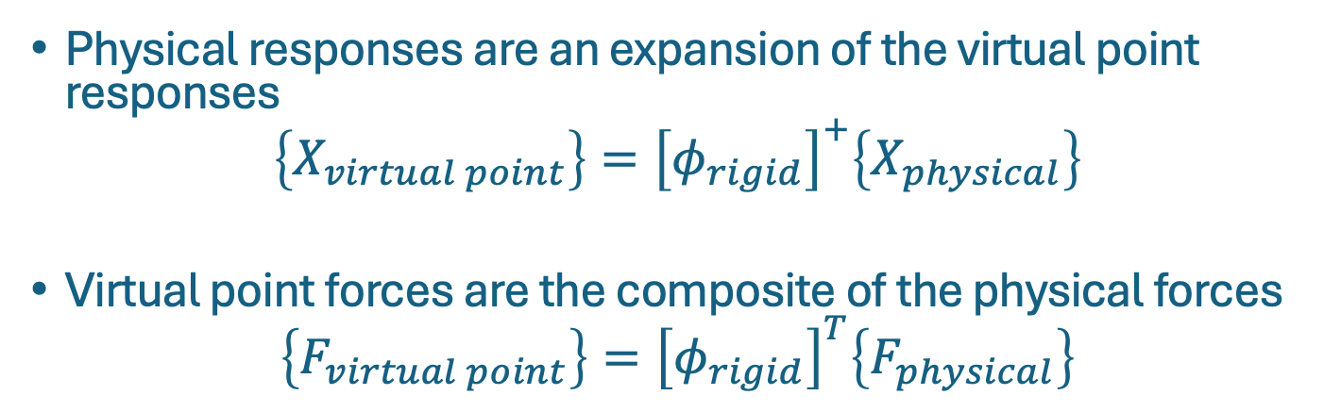
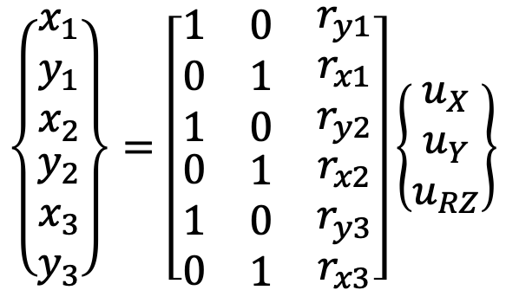

Building Transformation Matrices – Example
Need to think about the dependent and independent variables when creating transformation matrices
$$\left\{\begin{matrix}\begin{matrix}x_{1} \\ y_{1} \\ x_{2}\end{matrix} \\ \begin{matrix}y_{2} \\ x_{3} \\ y_{3}\end{matrix}\end{matrix}\right\}=\left[\begin{matrix}\begin{matrix}\begin{matrix}1 \\ 0 \\ 1\end{matrix} \\ \begin{matrix}0 \\ 1 \\ 0\end{matrix}\end{matrix} & \begin{matrix}\begin{matrix}0 \\ 1 \\ 0\end{matrix} \\ \begin{matrix}1 \\ 0 \\ 1\end{matrix}\end{matrix} & \begin{matrix}\begin{matrix}r_{y1} \\ r_{x1} \\ r_{y2}\end{matrix} \\ \begin{matrix}r_{x2} \\ r_{y3} \\ r_{x3}\end{matrix}\end{matrix}\end{matrix}\right]\left\{\begin{matrix}u_{X} \\ u_{Y} \\ u_{RZ}\end{matrix}\right\}$$
1
Transformation
$$\left\{X\right\}=\left[φ_{rigid}\right]\left\{U\right\}$$
2
3
VPT
Physical responses are an expansion of the virtual point responses
$$\left\{X_{virtual point}\right\}={\left[φ_{rigid}\right]}^{+}\left\{X_{physical}\right\}$$
Virtual point forces are the composite of the physical forces
$$\left\{F_{virtual point}\right\}={\left[φ_{rigid}\right]}^{T}\left\{F_{physical}\right\}$$

Slide 18
Building Transformation Matrices – Example
Need to think about the dependent and independent variables when creating transformation matrices
$$\left\{\begin{matrix}\begin{matrix}x_{1} \\ y_{1} \\ x_{2}\end{matrix} \\ \begin{matrix}y_{2} \\ x_{3} \\ y_{3}\end{matrix}\end{matrix}\right\}=\left[\begin{matrix}\begin{matrix}\begin{matrix}1 \\ 0 \\ 1\end{matrix} \\ \begin{matrix}0 \\ 1 \\ 0\end{matrix}\end{matrix} & \begin{matrix}\begin{matrix}0 \\ 1 \\ 0\end{matrix} \\ \begin{matrix}1 \\ 0 \\ 1\end{matrix}\end{matrix} & \begin{matrix}\begin{matrix}r_{y1} \\ r_{x1} \\ r_{y2}\end{matrix} \\ \begin{matrix}r_{x2} \\ r_{y3} \\ r_{x3}\end{matrix}\end{matrix}\end{matrix}\right]\left\{\begin{matrix}u_{X} \\ u_{Y} \\ u_{RZ}\end{matrix}\right\}$$
1
Transformation
$$\left\{X\right\}=\left[φ_{rigid}\right]\left\{U\right\}$$
2
3
VPT
Physical responses are an expansion of the virtual point responses
$$\left\{X_{virtual point}\right\}={\left[φ_{rigid}\right]}^{+}\left\{X_{physical}\right\}$$
Virtual point forces are the composite of the physical forces
$$\left\{F_{virtual point}\right\}={\left[φ_{rigid}\right]}^{T}\left\{F_{physical}\right\}$$
Translating rigid body shape in X-direction

Slide 19
Building Transformation Matrices – Example
Need to think about the dependent and independent variables when creating transformation matrices
$$\left\{\begin{matrix}\begin{matrix}x_{1} \\ y_{1} \\ x_{2}\end{matrix} \\ \begin{matrix}y_{2} \\ x_{3} \\ y_{3}\end{matrix}\end{matrix}\right\}=\left[\begin{matrix}\begin{matrix}\begin{matrix}1 \\ 0 \\ 1\end{matrix} \\ \begin{matrix}0 \\ 1 \\ 0\end{matrix}\end{matrix} & \begin{matrix}\begin{matrix}0 \\ 1 \\ 0\end{matrix} \\ \begin{matrix}1 \\ 0 \\ 1\end{matrix}\end{matrix} & \begin{matrix}\begin{matrix}r_{y1} \\ r_{x1} \\ r_{y2}\end{matrix} \\ \begin{matrix}r_{x2} \\ r_{y3} \\ r_{x3}\end{matrix}\end{matrix}\end{matrix}\right]\left\{\begin{matrix}u_{X} \\ u_{Y} \\ u_{RZ}\end{matrix}\right\}$$
1
Transformation
$$\left\{X\right\}=\left[φ_{rigid}\right]\left\{U\right\}$$
2
3
VPT
Physical responses are an expansion of the virtual point responses
$$\left\{X_{virtual point}\right\}={\left[φ_{rigid}\right]}^{+}\left\{X_{physical}\right\}$$
Virtual point forces are the composite of the physical forces
$$\left\{F_{virtual point}\right\}={\left[φ_{rigid}\right]}^{T}\left\{F_{physical}\right\}$$
Translating rigid body shape in Y-direction

Slide 20
Building Transformation Matrices – Example
Need to think about the dependent and independent variables when creating transformation matrices
$$\left\{\begin{matrix}\begin{matrix}x_{1} \\ y_{1} \\ x_{2}\end{matrix} \\ \begin{matrix}y_{2} \\ x_{3} \\ y_{3}\end{matrix}\end{matrix}\right\}=\left[\begin{matrix}\begin{matrix}\begin{matrix}1 \\ 0 \\ 1\end{matrix} \\ \begin{matrix}0 \\ 1 \\ 0\end{matrix}\end{matrix} & \begin{matrix}\begin{matrix}0 \\ 1 \\ 0\end{matrix} \\ \begin{matrix}1 \\ 0 \\ 1\end{matrix}\end{matrix} & \begin{matrix}\begin{matrix}r_{y1} \\ r_{x1} \\ r_{y2}\end{matrix} \\ \begin{matrix}r_{x2} \\ r_{y3} \\ r_{x3}\end{matrix}\end{matrix}\end{matrix}\right]\left\{\begin{matrix}u_{X} \\ u_{Y} \\ u_{RZ}\end{matrix}\right\}$$
1
Transformation
$$\left\{X\right\}=\left[φ_{rigid}\right]\left\{U\right\}$$
2
3
VPT
Physical responses are an expansion of the virtual point responses
$$\left\{X_{virtual point}\right\}={\left[φ_{rigid}\right]}^{+}\left\{X_{physical}\right\}$$
Virtual point forces are the composite of the physical forces
$$\left\{F_{virtual point}\right\}={\left[φ_{rigid}\right]}^{T}\left\{F_{physical}\right\}$$
Rotating rigid body shape

Slide 21
Building Transformation Matrices – Example
Need to think about the dependent and independent variables when creating transformation matrices
$$\left\{\begin{matrix}\begin{matrix}x_{1} \\ y_{1} \\ x_{2}\end{matrix} \\ \begin{matrix}y_{2} \\ x_{3} \\ y_{3}\end{matrix}\end{matrix}\right\}=\left[\begin{matrix}\begin{matrix}\begin{matrix}1 \\ 0 \\ 1\end{matrix} \\ \begin{matrix}0 \\ 1 \\ 0\end{matrix}\end{matrix} & \begin{matrix}\begin{matrix}0 \\ 1 \\ 0\end{matrix} \\ \begin{matrix}1 \\ 0 \\ 1\end{matrix}\end{matrix} & \begin{matrix}\begin{matrix}r_{y1} \\ r_{x1} \\ r_{y2}\end{matrix} \\ \begin{matrix}r_{x2} \\ r_{y3} \\ r_{x3}\end{matrix}\end{matrix}\end{matrix}\right]\left\{\begin{matrix}u_{X} \\ u_{Y} \\ u_{RZ}\end{matrix}\right\}$$
1
Transformation
$$\left\{X\right\}=\left[φ_{rigid}\right]\left\{U\right\}$$
2
3
VPT
Physical responses are an expansion of the virtual point responses
$$\left\{X_{virtual point}\right\}={\left[φ_{rigid}\right]}^{+}\left\{X_{physical}\right\}$$
Virtual point forces are the composite of the physical forces
$$\left\{F_{virtual point}\right\}={\left[φ_{rigid}\right]}^{T}\left\{F_{physical}\right\}$$

Slide 22
Building Transformation Matrices – Example
Need to think about the dependent and independent variables when creating transformation matrices
$$\left\{\begin{matrix}\begin{matrix}x_{1} \\ y_{1} \\ x_{2}\end{matrix} \\ \begin{matrix}y_{2} \\ x_{3} \\ y_{3}\end{matrix}\end{matrix}\right\}=\left[\begin{matrix}\begin{matrix}\begin{matrix}1 \\ 0 \\ 1\end{matrix} \\ \begin{matrix}0 \\ 1 \\ 0\end{matrix}\end{matrix} & \begin{matrix}\begin{matrix}0 \\ 1 \\ 0\end{matrix} \\ \begin{matrix}1 \\ 0 \\ 1\end{matrix}\end{matrix} & \begin{matrix}\begin{matrix}r_{y1} \\ r_{x1} \\ r_{y2}\end{matrix} \\ \begin{matrix}r_{x2} \\ r_{y3} \\ r_{x3}\end{matrix}\end{matrix}\end{matrix}\right]\left\{\begin{matrix}u_{X} \\ u_{Y} \\ u_{RZ}\end{matrix}\right\}$$
1
Transformation
$$\left\{X\right\}=\left[φ_{rigid}\right]\left\{U\right\}$$
2
3
VPT
Physical responses are an expansion of the virtual point responses
$$\left\{X_{virtual point}\right\}={\left[φ_{rigid}\right]}^{+}\left\{X_{physical}\right\}$$
Virtual point forces are the composite of the physical forces
$$\left\{F_{virtual point}\right\}={\left[φ_{rigid}\right]}^{T}\left\{F_{physical}\right\}$$

Slide 23
Interface Weakening with VPT

Slide 24
Why Don’t we use the Physical Measurements?
The equivalent multi-point connection typically over constrains the coupling and the VPT can eliminate redundant information
Equivalent Multi-point Connection
Virtual Point Connection
X
Y
X
X
X
RZ
Y
Y
Y
6 DOFs to constrain 3 DOFs
3 DOFs to constrain 3 DOFs

Slide 25
Why Don’t we use the Physical Measurements?
The equivalent multi-point connection typically over constrains the coupling and the VPT can eliminate redundant information
Equivalent Multi-point Connection
Virtual Point Connection
X
Y
The virtual point transformation is a spatial filter and will eliminate any information that isn’t compatible with the transformation definition
X
X
X
RZ
Y
Y
Y
6 DOFs to constrain 3 DOFs
3 DOFs to constrain 3 DOFs

Slide 26
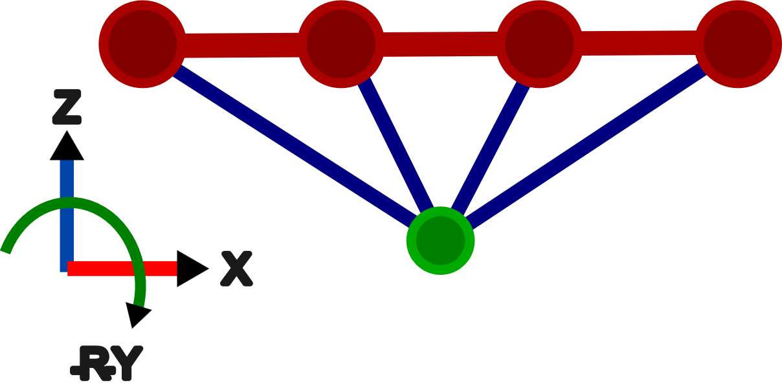
Effect of Spatial Filtering on Measurement Noise
Example System
Beam
Point
Point and beam are rigidly connected
Test is simulated with measurement errors
Point FRFs are estimated directly and with beam FRFs using the VPT

Slide 27
Effect of Spatial Filtering on Measurement Noise
Example System
Beam
Point
Point and beam are rigidly connected
Test is simulated with measurement errors
Point FRFs are estimated directly and with beam FRFs using the VPT

Slide 28
Effect of Spatial Filtering on Measurement Noise
Example System
Beam
Point
Point and beam are rigidly connected
Point FRFs are estimated directly and with beam FRFs using the VPT
Test is simulated with measurement errors

Slide 29
Effect of Spatial Filtering on Measurement Noise
Example System
Beam
Point
Point and beam are rigidly connected
Point FRFs are estimated directly and with beam FRFs using the VPT
Test is simulated with measurement errors

Slide 30
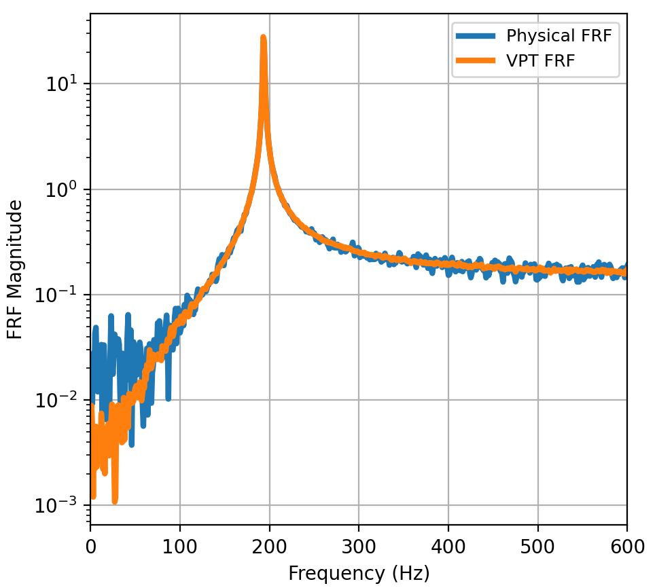
Effect of Spatial Filtering on Measurement Noise
Sample Physical and VPT FRF
Example System
Beam
Point
Point and beam are rigidly connected
Point FRFs are estimated directly and with beam FRFs using the VPT
Test is simulated with measurement errors
The VPT can help reduce measurement errors in FRFs

Slide 31
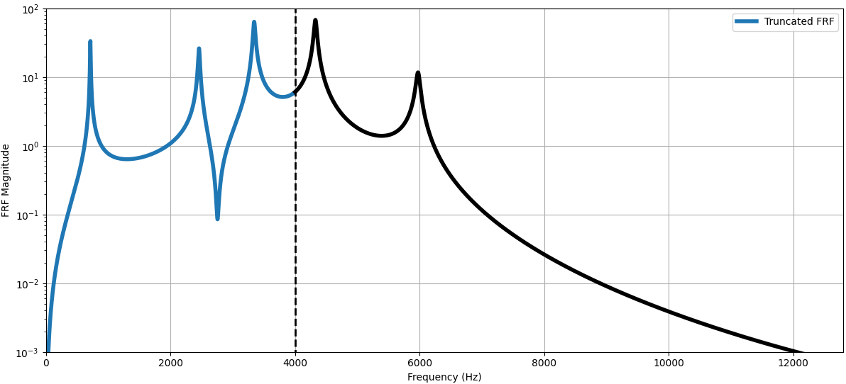
Effect of Spatial Filtering on System Dynamics
Measured
Unmeasured
Filtering out the residual effects of the high frequency modes may or may not be desirable (similar to modal truncation in CMS), depending on the problem

Slide 32
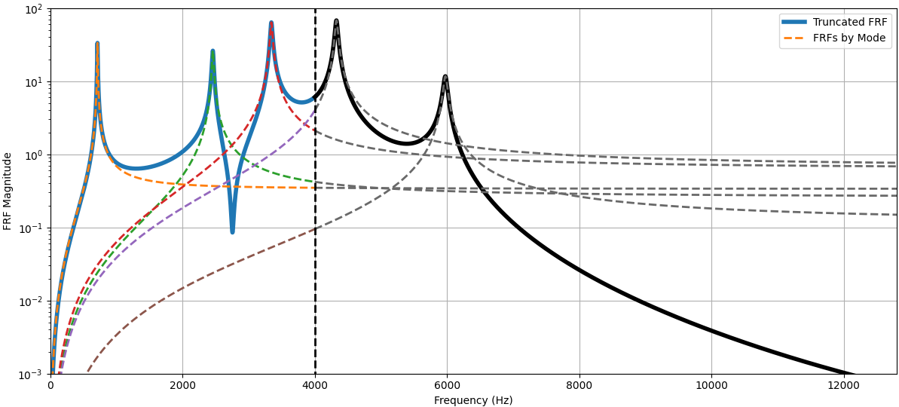
Effect of Spatial Filtering on System Dynamics
Measured
Unmeasured
Filtering out the residual effects of the high frequency modes may or may not be desirable (similar to modal truncation in CMS), depending on the problem

Slide 33
Effect of Spatial Filtering on System Dynamics
The VPT could be used to filter out the residual effects of high frequency modes, which weakens the coupling constraint
Measured
Unmeasured
Filtering out the residual effects of the high frequency modes may or may not be desirable (similar to modal truncation in CMS), depending on the problem

Slide 34
Closing Remarks for the VPT

Slide 35
Basic Guidance for using the VPT
While the VPT seems like a simple concept, there are many non-intuitive aspects with the transformation
Have a robust process for documenting all the extra information from the VPT
All the extra data
Individual sensor locations and orientations
Virtual point location and orientation
Simplify the process and make sure that the measurements in the VPT can be transformed with rigid body shapes – a handful of metrics are available to help with this

Slide 36
Basic Guidance for using the VPT
While the VPT seems like a simple concept, there are many non-intuitive aspects with the transformation
Have a robust process for documenting all the extra information from the VPT
All the extra data
Individual sensor locations and orientations
Virtual point location and orientation
Simplify the process and make sure that the measurements in the VPT can be transformed with rigid body shapes – a handful of metrics are available to help with this

Slide 37
Basic Guidance for using the VPT
While the VPT seems like a simple concept, there are many non-intuitive aspects with the transformation
Have a robust process for managing all the extra information from the VPT
All the extra data
Individual sensor locations and orientations
Virtual point location and orientation
Simplify the process and make sure that the measurements in the VPT can be transformed with rigid body shapes – a handful of metrics are available to help with this

Slide 38
Basic Guidance for using the VPT
While the VPT seems like a simple concept, there are many non-intuitive aspects with the transformation
Have a robust process for managing all the extra information from the VPT
All the extra data
Individual sensor locations and orientations
Virtual point location and orientation
Simplify the process and make sure that the measurements in the VPT can be transformed with rigid body shapes – a handful of metrics are available to help with this

Slide 39
Advice for Setting Up a Virtual Point
Should have 1.5-2x the number of physical DOFs vs. virtual point DOFs – it’s nice to be able to drop measurements that mess-up the processing
Choose locations that are easy access and define – no need for driving point FRFs
Use tools to automate the test geometry generation – small errors in the test geometry could lead to significant problems in the virtual point
Keep a close eye on data quality

Slide 40
Advice for Setting Up a Virtual Point
Should have 1.5-2x the number of physical DOFs vs. virtual point DOFs – it’s nice to be able to drop measurements that mess-up the processing
Choose locations that are easy access and define – no need for driving point FRFs
Use tools to automate the test geometry generation – small errors in the test geometry could lead to significant problems in the virtual point
Keep a close eye on data quality

Slide 41
Advice for Setting Up a Virtual Point
Should have 1.5-2x the number of physical DOFs vs. virtual point DOFs – it’s nice to be able to drop measurements that mess-up the processing
Choose locations that are easy access and define – no need for driving point FRFs
Use tools to automate the test geometry generation – small errors in the test geometry could lead to significant problems in the virtual point
Keep a close eye on data quality

Slide 42
Advice for Setting Up a Virtual Point
Should have 1.5-2x the number of physical DOFs vs. virtual point DOFs – it’s nice to be able to drop measurements that mess-up the processing
Choose locations that are easy access and define – no need for driving point FRFs
Use tools to automate the test geometry generation – small errors in the test geometry could lead to significant problems in the virtual point
Keep a close eye on data quality

Slide 43
Advice for Setting Up a Virtual Point
Should have 1.5-2x the number of physical DOFs vs. virtual point DOFs – it’s nice to be able to drop measurements that mess-up the processing
Choose locations that are easy access and define – no need for driving point FRFs
Use tools to automate the test geometry generation – small errors in the test geometry could lead to significant problems in the virtual point
Keep a close eye on data quality

Slide 44
Next Up: Decoupling

